Slide 1
AI-POWERED PERSONAL HEALTH COPILOT
TEAM NAME:SPARKVISION

Slide 2
PROBLEM STATEMENT
Healthcare information is often scattered across medical reports, prescriptions, diagnostic results, and appointment records. Patients may struggle to understand medical terminology, remember medicine schedules, track appointments, and access important health information when needed.
There is a need for a user-friendly AI-powered platform that helps individuals understand medical information, organize their health records, and manage healthcare activities in one place.

Slide 3
PROPOSED SOLUTION
HealthMate AI is a personal health assistant designed to make healthcare information easier to understand and manage.
The repository describes these main capabilities:
GitHub
AI-powered medical report analysis.
Answers to health-related questions.
Medicine reminders.
Appointment tracking.
A convenient digital health assistant.
The goal is to bring these activities together in a simple, user-friendly experience.

Slide 4
KEY FEATURES
1. Medical Report Analysis
Helps users understand information contained in medical reports using AI-generated explanations.
2. Health Query Assistant
Allows users to ask health-related questions and receive AI-generated responses.
3. Medicine Reminders
Helps users keep track of scheduled medicines and reminder times.
4. Appointment Tracking
Helps users organize upcoming healthcare appointments.
These are capabilities described by the repository. Confirm each feature in the running application before claiming it is fully implemented.

Slide 5
SYSTEM WORKFLOW
USER Uploads a report or asks a health question
FRONTEND INTERFACE Receives user input and displays results
BACKEND PROCESSING Processes requests and coordinates the required operations
AI PROCESSING Analyzes available information and generates a response
RESULT TO USER Health explanation or relevant assistant response

Slide 6
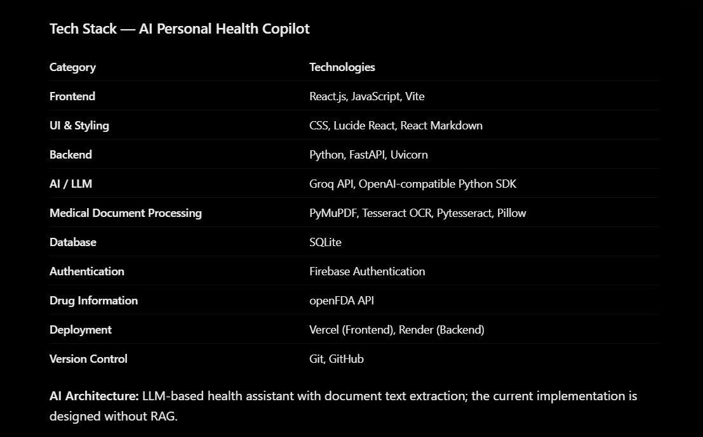
TECHNOLOGY AND ARCHITECTURE

Slide 7
EXPECTED BENEFITS
Makes medical information easier to understand.
Helps users organize healthcare activities.
Supports timely medicine reminders.
Makes appointment tracking more convenient.
Provides easier access to health-related information.
Encourages users to prepare for conversations with healthcare professionals.

Slide 8
SAFETY AND PRIVACY FUTURE ENHANCEMENT
Protect personal and medical information.
Avoid exposing API keys or medical records publicly.
Clearly identify AI-generated explanations.
Do not present AI responses as a confirmed diagnosis.
Encourage consultation with qualified healthcare professionals.
Tamil and other regional-language support.
OCR for scanned medical reports and prescriptions.
A unified, chronological health-record timeline.
Secure integration with health-data standards such as FHIR.
Voice-based interaction and accessible controls.

